Slide 1

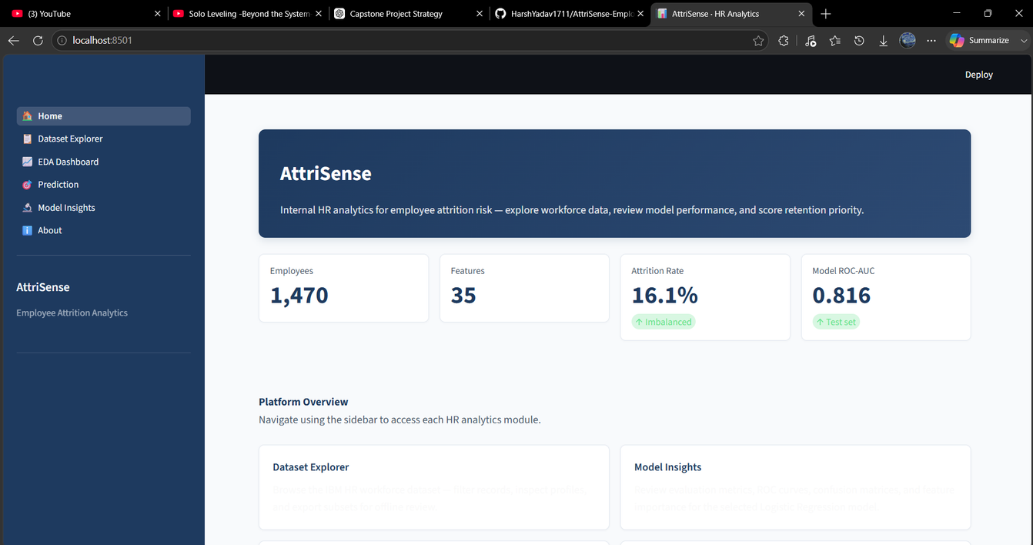
ATTRISENSE
Home
Dataset Explorer
Prediction
Model Insights
ATTRISENSE
AI-Powered Employee
& Explainable HR Analytics Platform
Submitted By
Harsh Yadav
Roll No: 2300100100170
B.Tech Computer Science & Engineering
United College of Engineering & Research
Project Guide: Dr. Astha Singh
Summer Training Project
Department of Computer Science & Engineering
Machine Learning • Explainable AI • Streamlit

Slide 2

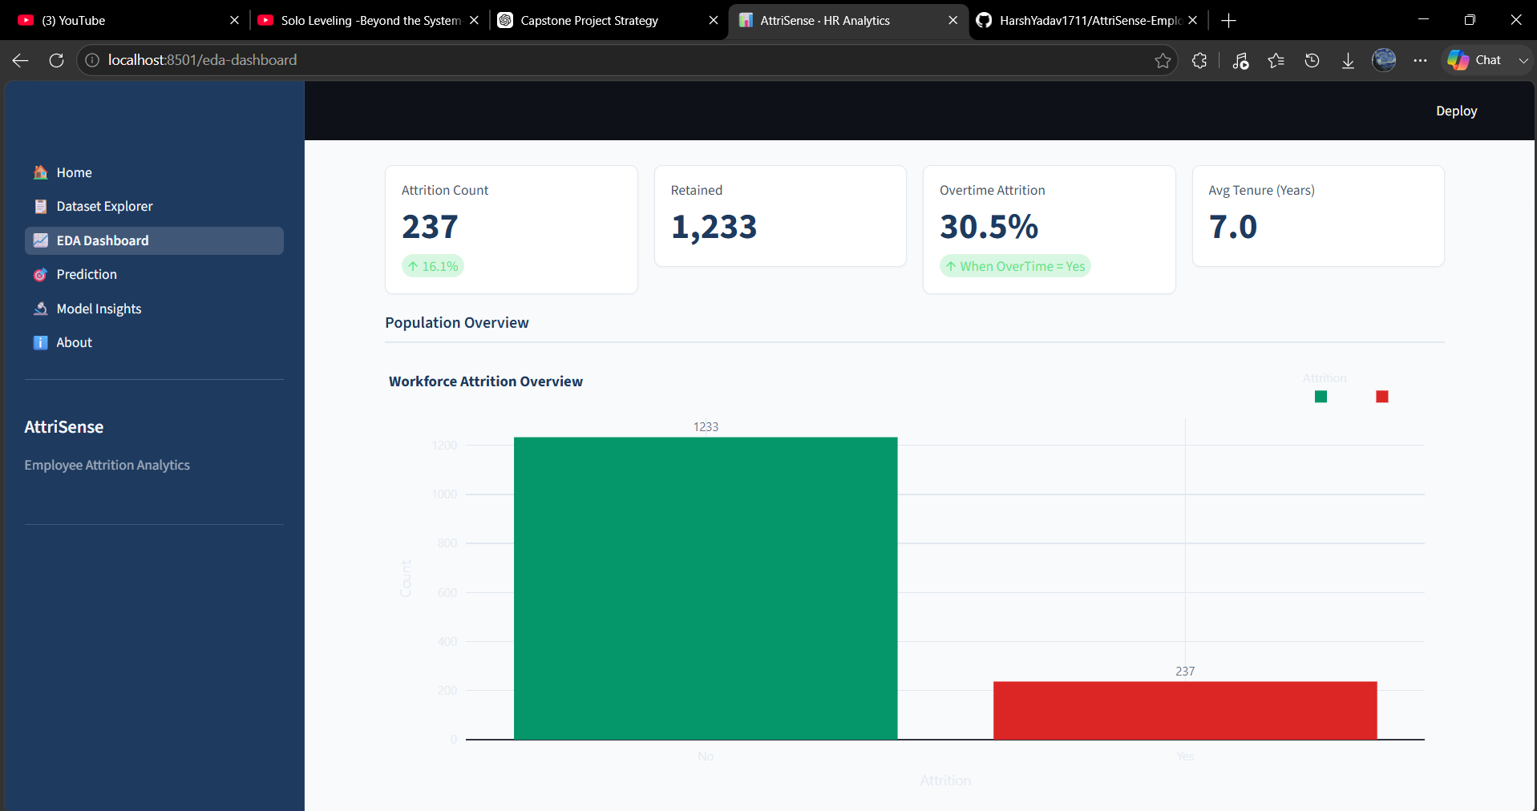
ATTRISENSE
PROBLEM STATEMENT & MOTIVATION
Problem Statement
Employee attrition leads to increased hiring costs and productivity loss.
Traditional HR methods rely on manual analysis and historical reports.
Identifying high-risk employees proactively is difficult.
My Solution
AI-based employee attrition prediction.
Interactive HR analytics dashboard.
Explainable AI using SHAP values.
Data-driven decision support for HR teams.
IBM HR Analytics Dataset
1,470 Employees
35 Features
16.1% Attrition Rate
Project Goals
✔ Predict employee attrition
✔ Analyze workforce trends
✔ Explain model predictions using SHAP
✔ Support HR decision-making

Slide 3
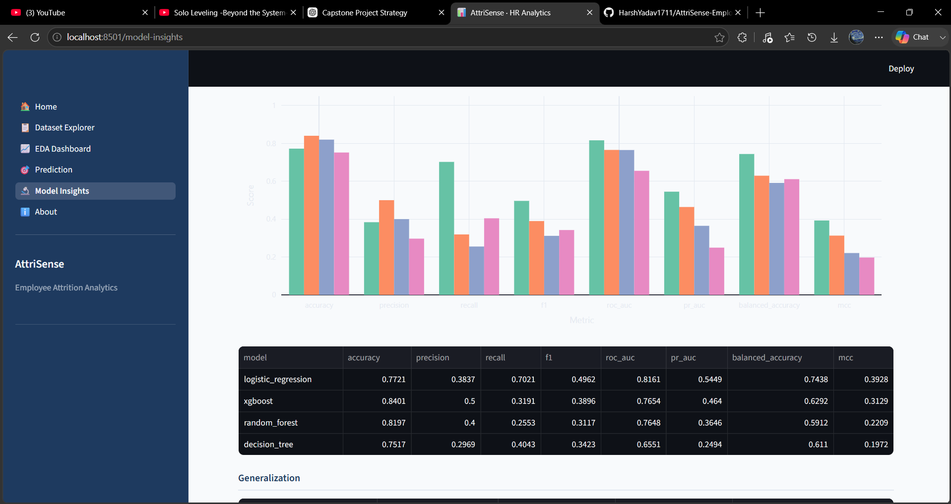
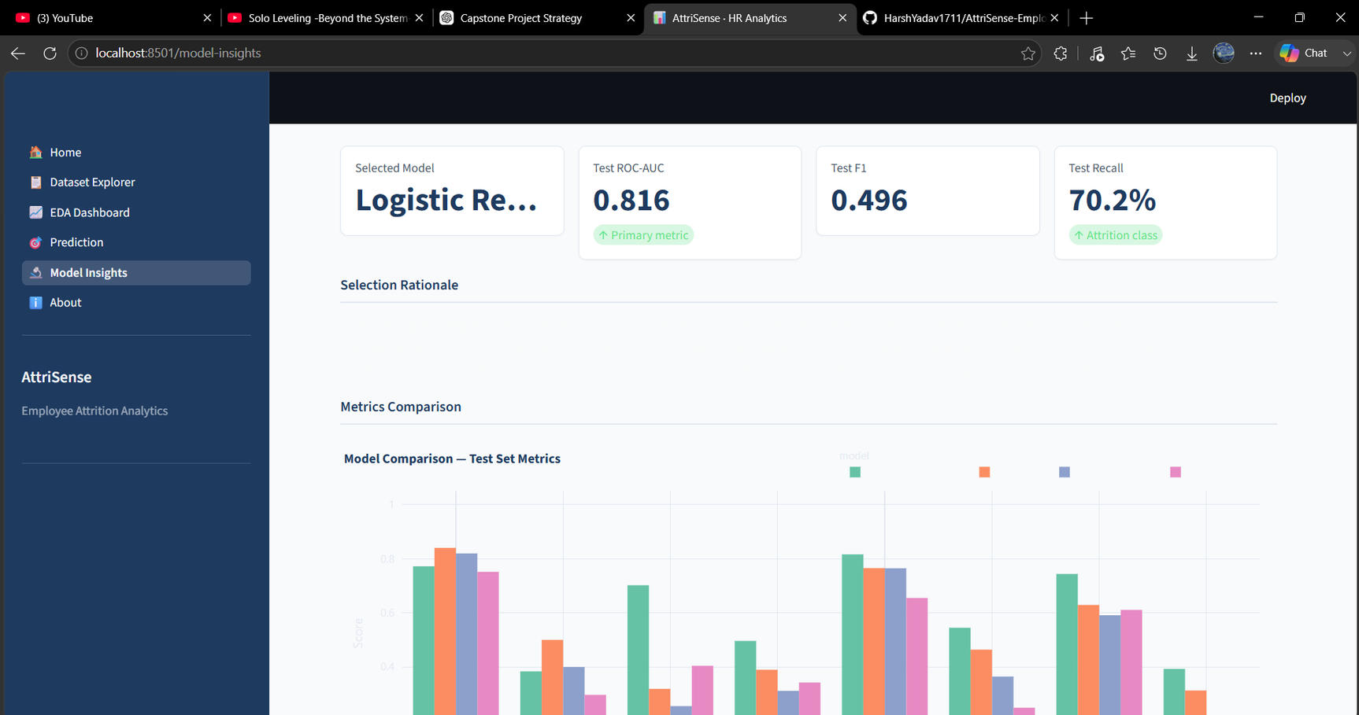

ATTRISENSE
PROJECT OVERVIEW
AttriSense is an AI-powered HR analytics platform developed to predict employee attrition using machine learning. The system combines predictive analytics, interactive dashboards, and Explainable AI (SHAP) to help HR teams identify employees at risk and make data-driven retention decisions.
Predict employee attrition accurately
Analyze workforce trends through dashboards
Explain every prediction using SHAP
Support HR decision-making with interpretable AI

Slide 4
ATTRISENSE
Predictive Analytics
📈
Predicts employee attrition risk using four machine learning models.
Displays probability score, confidence score, and predicted outcome.
KEY FEATURES
Interactive HR Dashboard
🤖
Workforce statistics and attrition KPIs
Feature comparison
Workforce trend analysis
Model performance metrics
AttriSense combines machine learning, interactive analytics, and Explainable AI into a single platform, enabling HR professionals to predict employee attrition, analyze workforce trends, and understand the reasoning behind every prediction.
Explainable AI (SHAP)
🧠
Explains why a prediction was made
Shows top feature contributions
Improves transparency and trust in HR decisions

Slide 5

ATTRISENSE
AttriSense consists of multiple integrated modules that provide workforce analytics, employee attrition prediction, model evaluation, and Explainable AI through an intuitive Streamlit interface.
SYSTEM MODULES
Data Analytics
Prediction Engine
Explainable AI
• Dataset Explorer
• Workforce statistics
• Interactive EDA
• HR insights
• Logistic Regression
• Random Forest
• XGBoost
• Decision Tree
• SHAP explanations
• Feature importance
• Prediction transparency
• HR recommendations

Slide 6


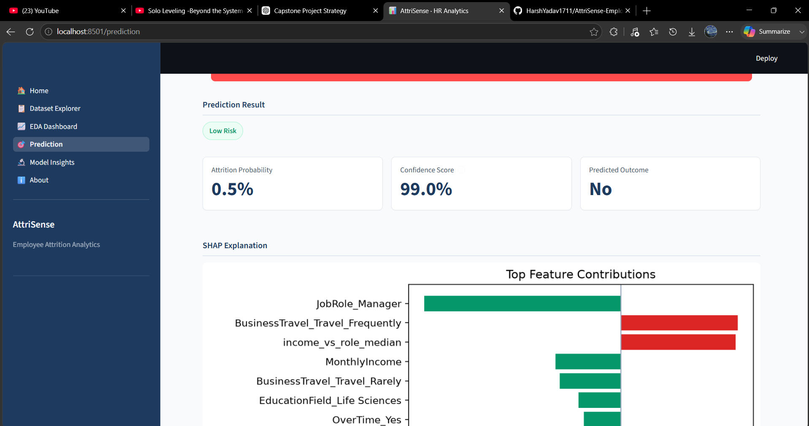


ATTRISENSE
METHODOLOGY
DATA COLLECTION
DATA PROCESSING
IBM HR Dataset
1470 Employees
35 Features
Encoding
Scaling
Feature Engineering
Train/Test Split
MODEL DEVELOPMENT
DEPLOYMENT
Logistic Regression
Decision Tree
Random Forest
XGBoost
Streamlit
SHAP
Interactive Dashboard

Slide 7

ATTRISENSE
MACHINE LEARNING MODELS
Four supervised machine learning algorithms were trained and evaluated to identify the most effective approach for predicting employee attrition.
Random Forest
XGBoost
Logistic Regression
Good robustness
Feature importance
Handles nonlinearities
High predictive power
Gradient boosting
Excellent calibration
AUC
0.816
Interpretable baseline

Slide 8
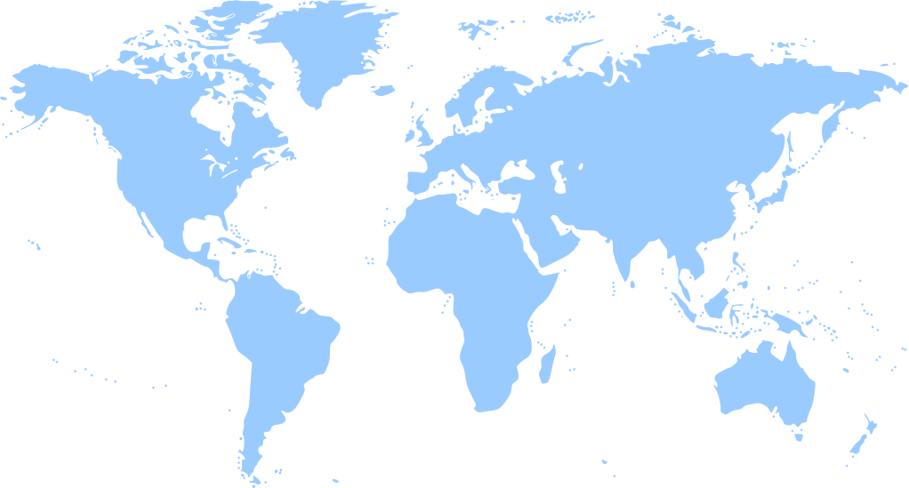
ATTRISENSE
RESULTS & MODEL PERFORMANCE
Accuracy
84%
Highest Overall Accuracy
(or your actual value)
Multiple evaluation metrics were used to compare the predictive performance of all trained models. Logistic Regression achieved the highest ROC-AUC, while XGBoost demonstrated excellent calibration performance.
ROC-AUC
0.816
Best Performing Model

Slide 9
ATTRISENSE
KEY FINDINGS
Overtime
Job Satisfaction
Income
Explainable AI
Employees working overtime showed
30.5%
attrition.
Low satisfaction
showed highest
attrition.
Lower income
associated with
higher attrition.
SHAP identifies
major factors behind
each prediction.

Slide 10
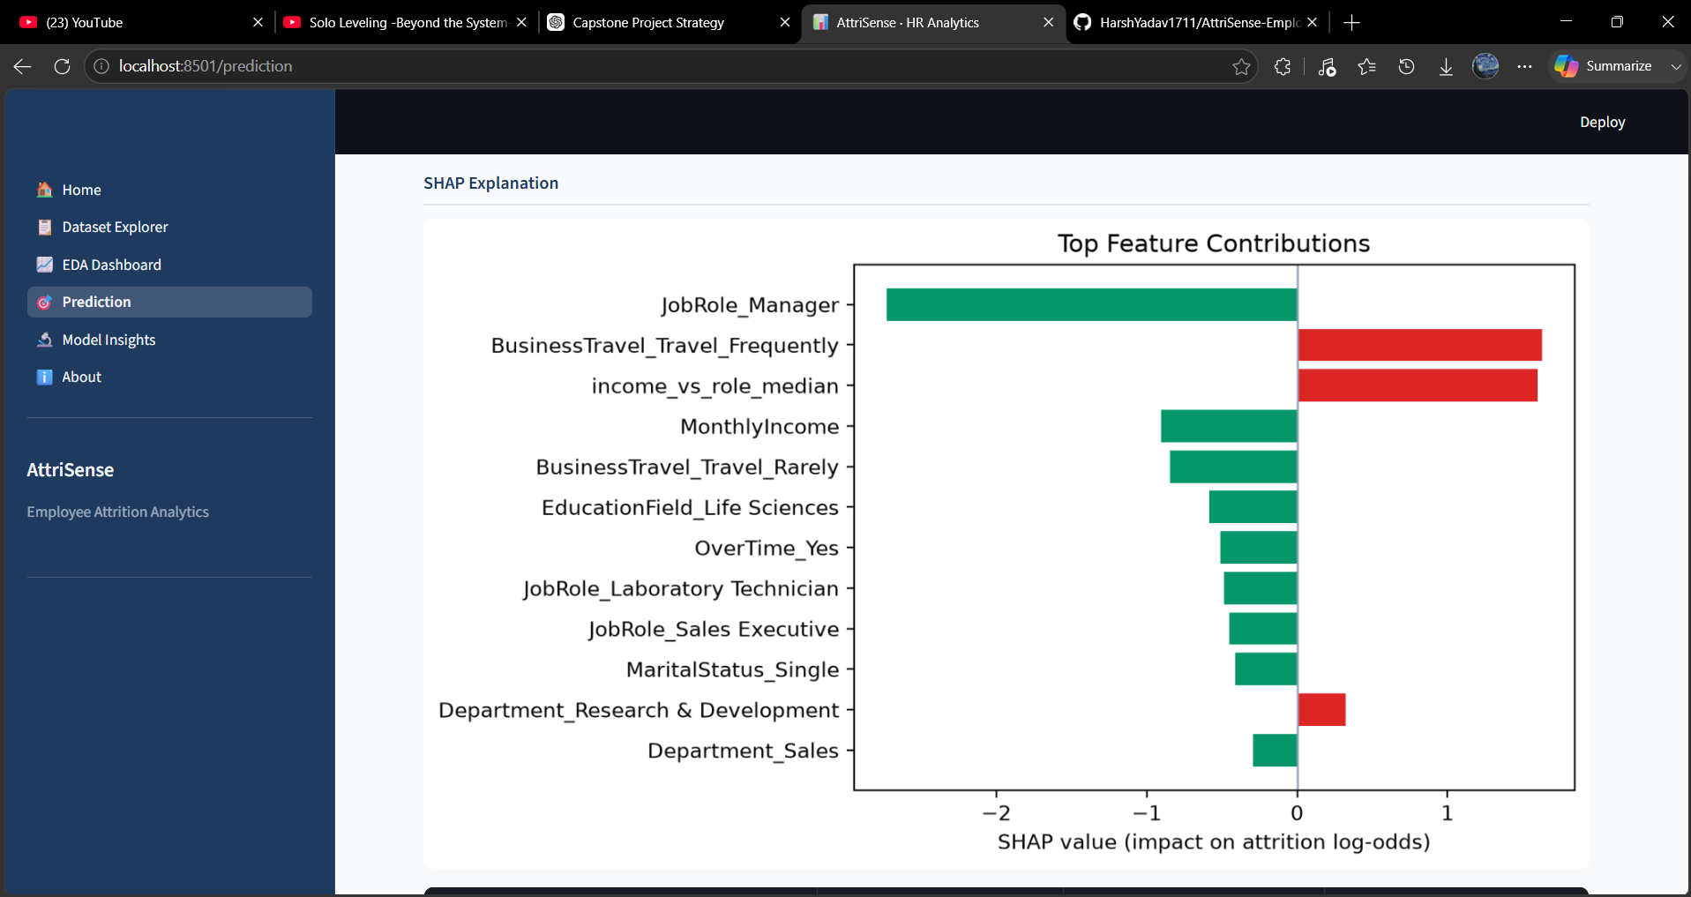
ATTRISENSE
Dashboard
Prediction
Insights
Explainable AI
THANK YOU
Developer: Harsh Yadav
College: United College of Engineering & Research
Guide: Dr. Astha Singh

